Slide 1

The Art of Intelligence – Introduction Machine Learning for Java professionals
Lucas Jellema
AMIS (The Netherlands)
@lucasjellema
technology.amis.nl
#DevoxxMA
Notes:
Our technology has gotten smart and fast enough to make predictions and come up with recommendations in near real time. Machine Learning is the art of deriving models from our Big Data collections – harvesting historic patterns and trends – and applying those models to new data in order to rapidly and adequately respond to that data. This presentation will explain and demonstrate in simple, straightforward terms and using easy to understand practical examples what Machine Learning really is and how it can be useful in our world of applications, integrations and databases. Hadoop and Spark, real time and streaming analytics, Watson and Cloud Datalab, Jupyter Notebooks and Citizen Data Scientists will all make their appearance, as will SQL.
Overview session:
Increasing numbers of data sets are gathered - from IoT, Social Media, Documents - into Data Lakes, Hadoop clusters, NOSQL databases, Message Queues, Elastic Search Indexes, plain old file systems and relational databases. What good can all that data do? How we can put it to good use?
Machine Learning is a hot topic - a seemingly magical term that promises us the world. But how to unlock that magic?
In this session, I will explain what ML entails, how it can enrich applications (predictions) and user experience (speech recognition, chat bot, recommendations) - and how organizations can get started with it. Which technologies are available, how is machine learning accessible to Java programmers, and what is a sensible approach.
It is not so much a success story of existing customers and more a guide for making first explorations into the brave new world of machine learning.

Slide 2


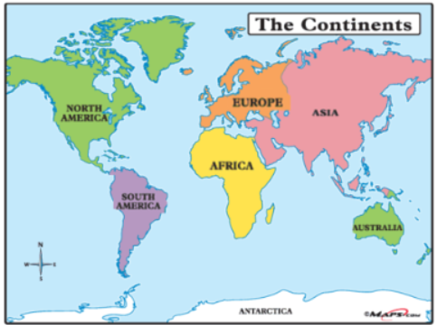

Who am I?
From The Netherlands, father of two sons
Masters in Applied Physics
Started in IT in 1994: Oracle; now CTO of AMIS
Solution Architect for enterprise IT challenges
Oracle ACE Director, Oracle Developer Champion, Java Rockstar
Presenter: Oracle OpenWorld, JavaOne, NLJUG JFall/JSpring, Javapolis/Devoxx, YouTube
Author of two books on Oracle SOA Suite, 1400 blog articles and 7000+ Tweets
#DevoxxMA

Slide 3
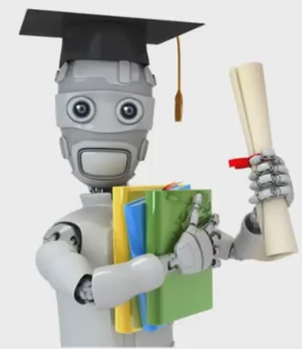
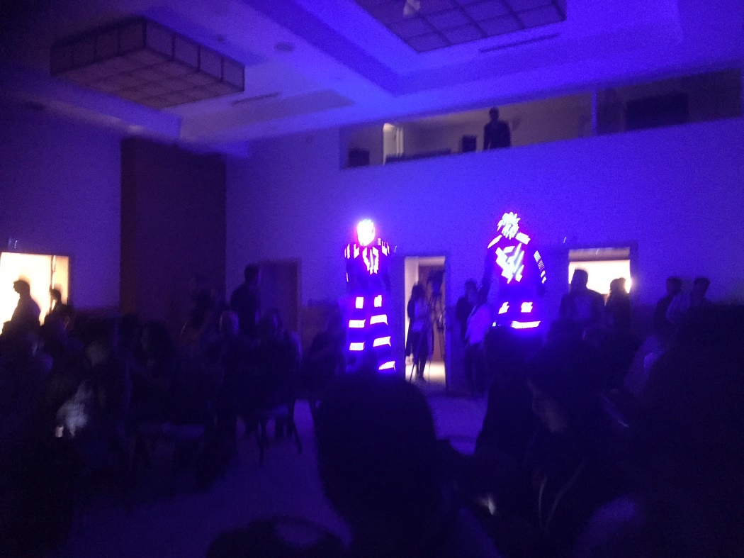
Overview
What is Machine Learning?
Why could it be relevant [to you]?
#DevoxxMA

Slide 4
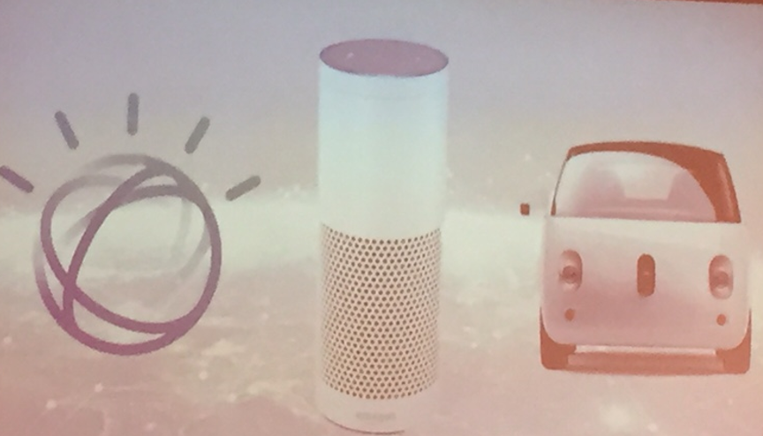
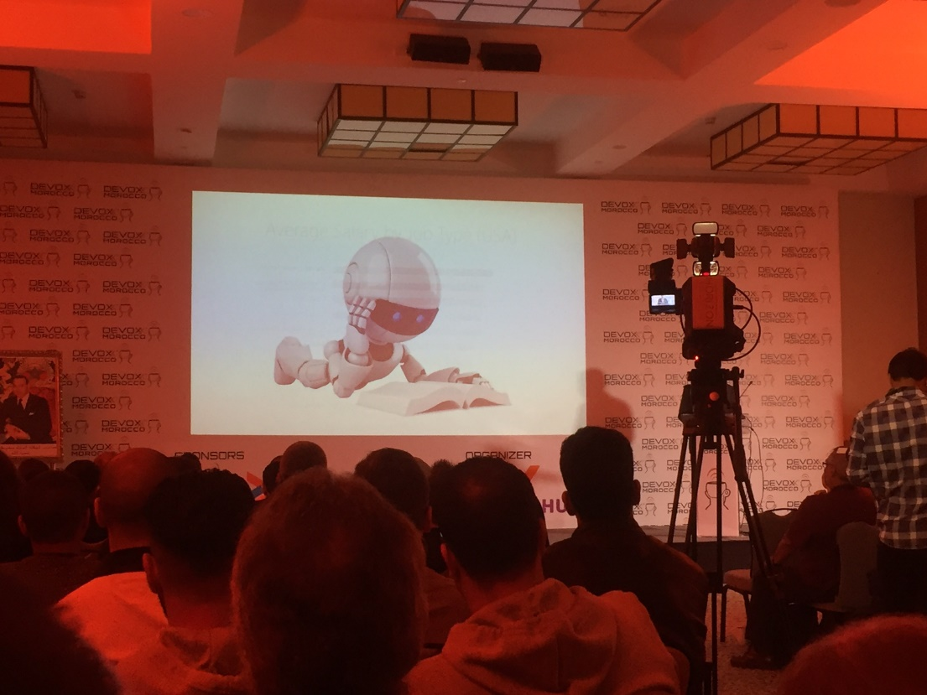
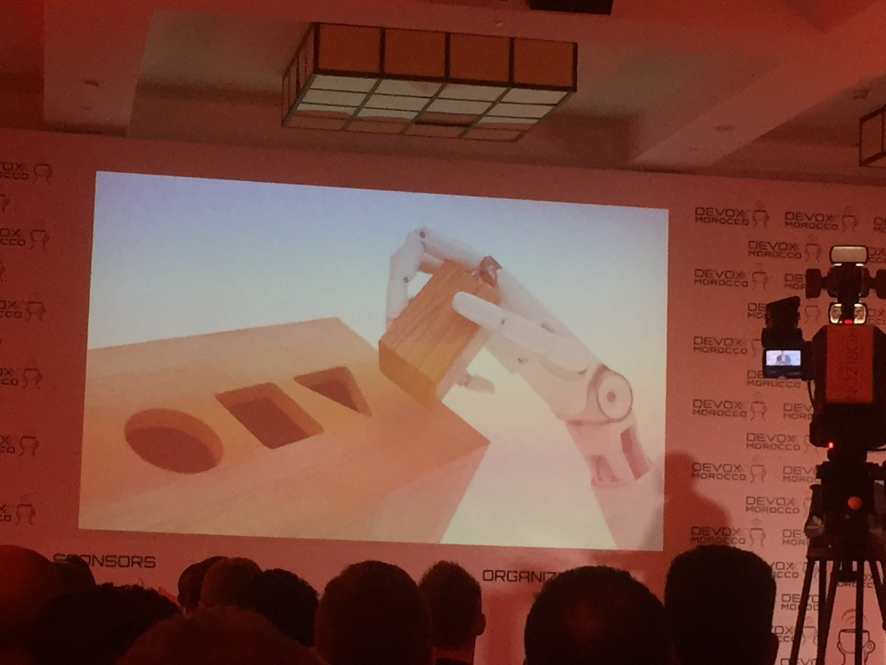
Overview
#DevoxxMA

Slide 5
Overview
What is Machine Learning?
Why could it be relevant [to you]?
What does it entail?
With which algorithms, tools and technologies?
Demo: classifying JavaOne & Devoxx Maroc conference sessions
How do you embark on Machine Learning?
#DevoxxMA

Slide 6
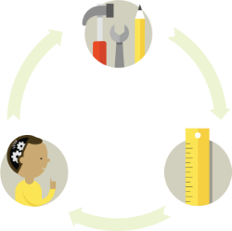
Learning
How do we learn?
Try something (else) => get feedback => learn
Eventually:
We get it (understanding) so we can predict the outcome of a certain action in a new situation
Or we have experienced enough situations to predict the outcome in most situations with high confidence
Through interpolation, extrapolation, etc.
We remain clueless
#DevoxxMA

Slide 7

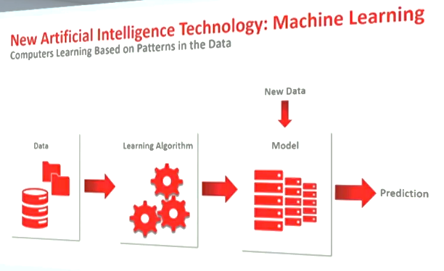
Machine Learning
Analyze Historical Data (input and result – training set) to discover Patterns & Models
Iteratively apply Models to [additional] Input (test set) and compare model outcome with known actual result to improve the model
Use Model to predict outcome for entirely new data
#DevoxxMA

Slide 8
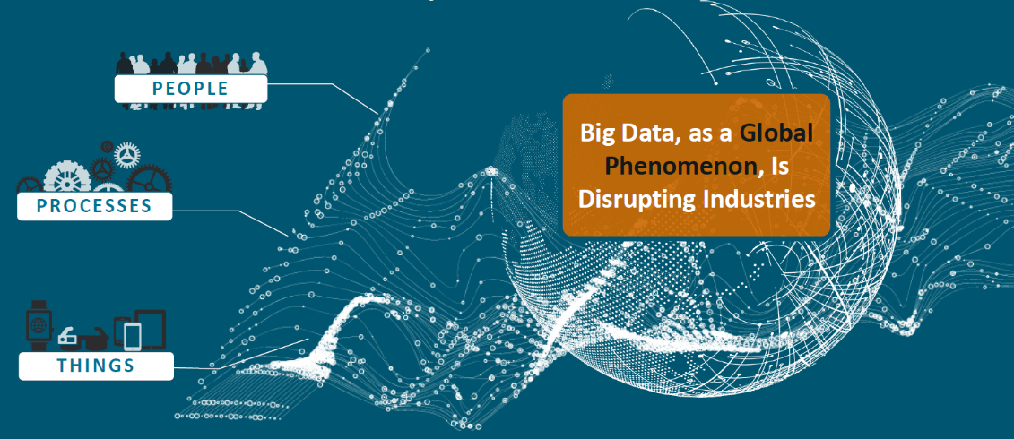
Why is it relevant (now)?
Data
big, fast, open
Machine Learning has become feasible and accessible
Available
Affordable (software & hardware)
Doable (Citizen Data Scientist)
Fast enough
Business Cases & Opportunities => Demands
End users, Consumers, Competitive pressure, Society
#DevoxxMA

Slide 9
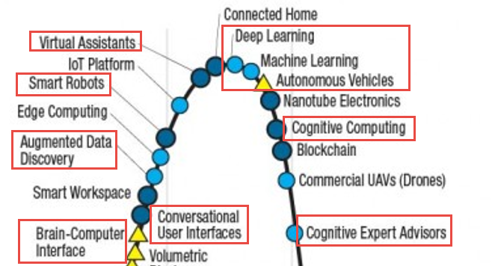
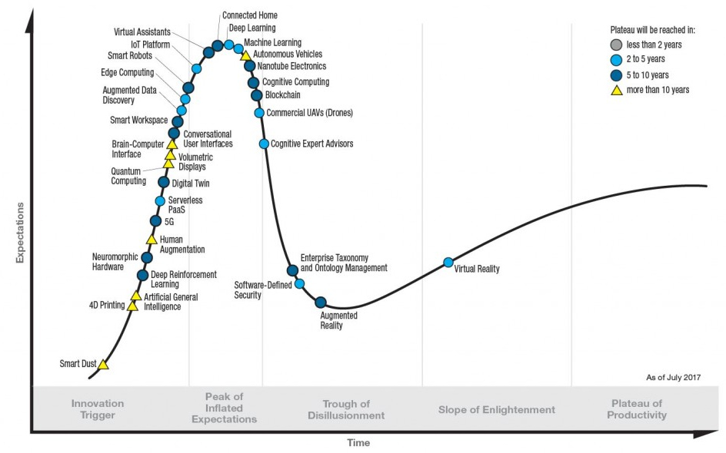
Why is it relevant (now)?
.
#DevoxxMA

Slide 10
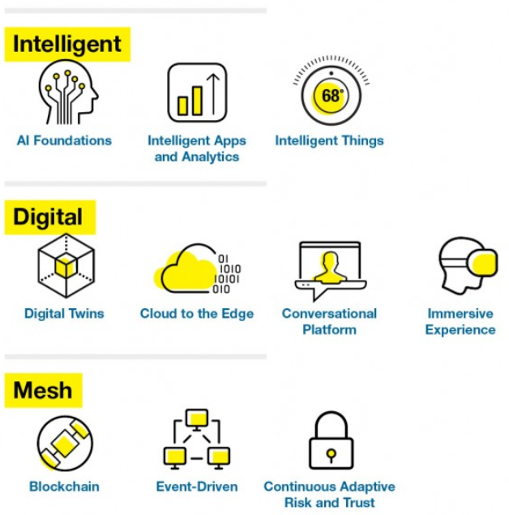

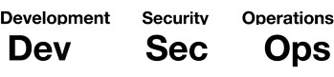
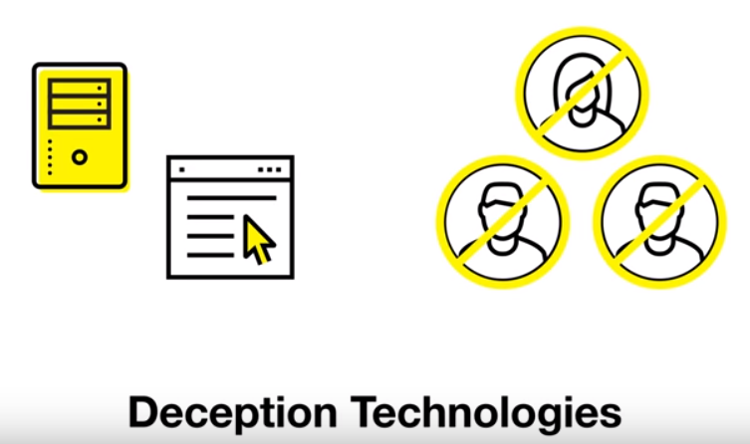
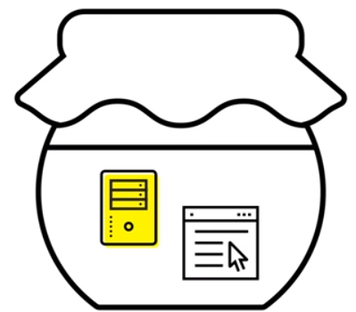
Gartner – Strategic Technology Trends 2018
.
#DevoxxMA

Slide 11
Example use cases
Speech recognition
Identify churn candidates
Intent & Sentiment analysis on social media
Upsell & Cross Sell
Target Marketing
Customer Service
Chat bots & voice response systems
Predictive Maintenance
Gaming
Captcha
Medical Diagnosis
Anomaly Detection (find the odd one out)
Autonomous Cars
Voter Segment Analysis
Customer Recommendations
Smart Data Capture
Face Detection
Fraud Prevention
(really good) OCR
Traffic light control
Navigation
Should we investigate | do lab test?
Spam filtering
Propose friends | contacts
Troll detection
Auto correct
Photo Tagging and Album organization
#DevoxxMA

Slide 12
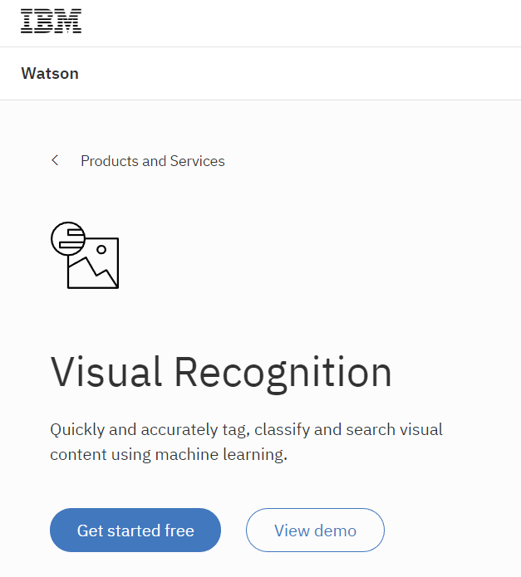
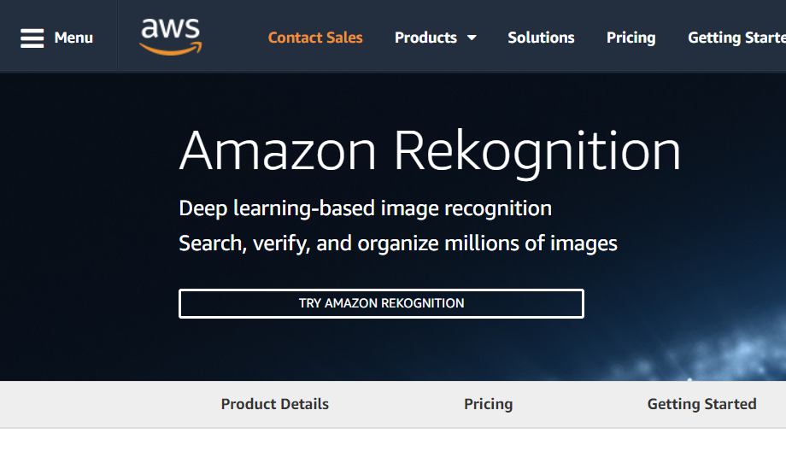
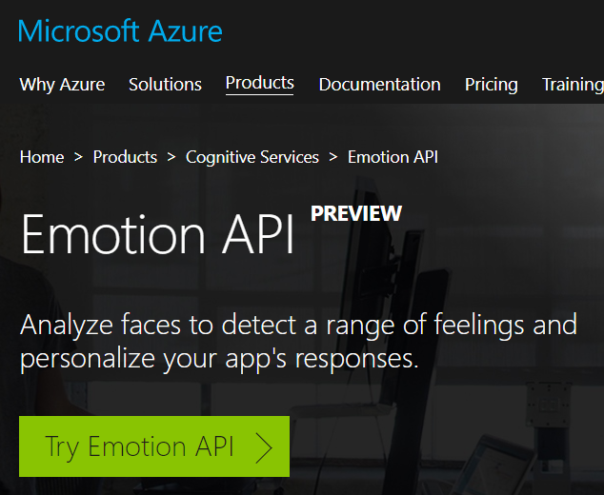
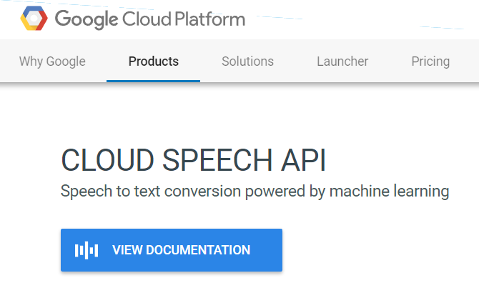
Ready to Run ML apps
#DevoxxMA

Slide 13
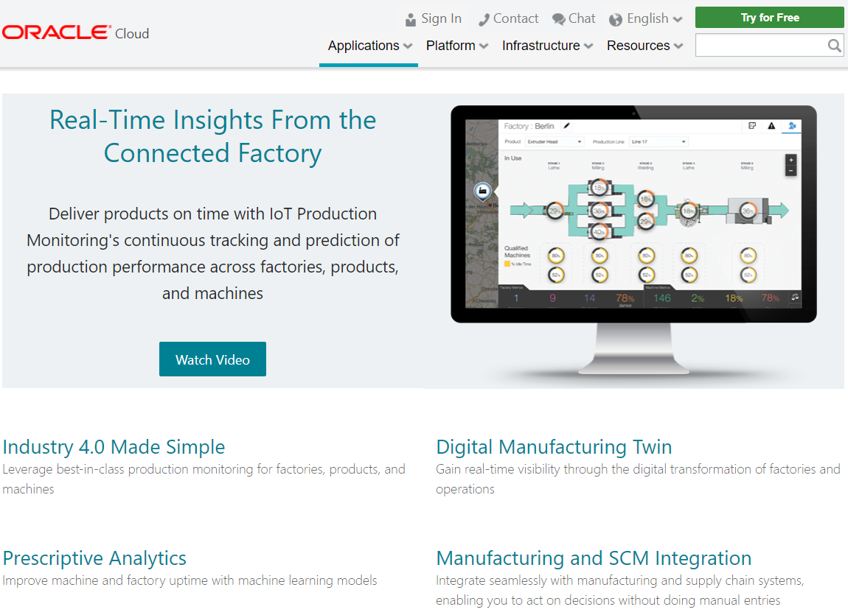
Ready to Run ML apps
#DevoxxMA

Slide 14
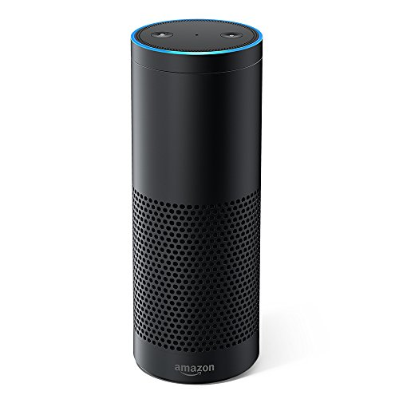
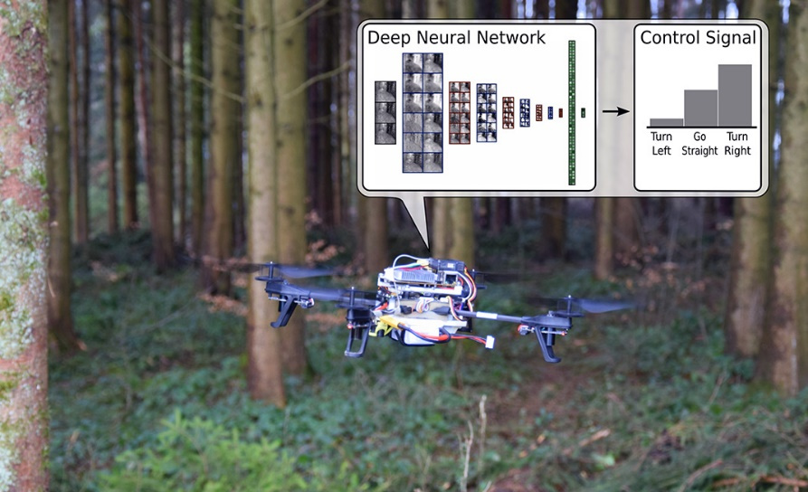
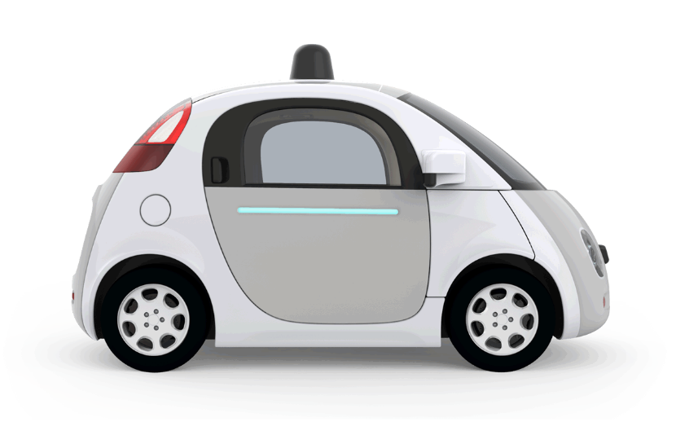

Products with ML inside
#DevoxxMA

Slide 15
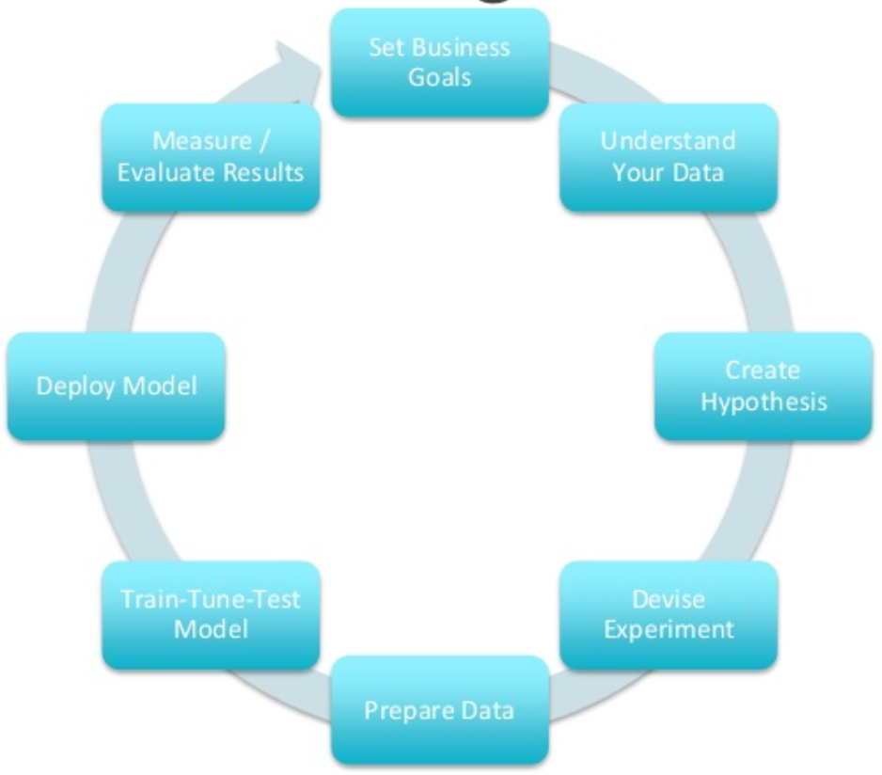

The Data Science workflow
Set Business Goal – research scope, objectives
Gather data
Prepare data
Cleanse, transform (wrangle), combine (merge, enrich)
Explore data
Model Data
Select model, train model, test model
Present findings and recommend next steps
Apply:
Make use of insights in business decisions & operations
Automate Data Gathering & Preparation, Deploy Model, Embed Model in operational systems
#DevoxxMA

Slide 16
Data Discovery
A | B | C | D | E | F | G
1104534 | ZTR | 0.1 | anijs | 2 | 36 | T
631148 | ESE | 132 | rivier | 0 | 21 | S
-3 | WGN | 71 | appel | 0 | 1 | -
1262300 | ZTR | 56 | zes | 2 | 41 | T
315529 | HVN | 1290 | hamer | 0 | 11 | -
788914 | ASM | 676 | zwaluw | 0 | 26 | T
157762 | HVN | 9482 | wie | 0 | 6 | -
946681 | DHG | 42 | rond | 1 | 31 | T
-31539 | WGN | 2423 | bruin | 0 | 0 | -
47338 | HVN | 54 | hamer | 0 | 16 | P
.
#DevoxxMA

Slide 17
Scatter Plot Attribute F (Y-axis)vs Attribute A
.
#DevoxxMA

Slide 18
Scatter Plot Attribute F (Y-axis)vs Attribute A
.
#DevoxxMA

Slide 19
Data Discovery – Attributes identified
Time | City | - | - | #Kids | Age | Level of Education
1104534 | ZTR | 0.1 | anijs | 2 | 36 | T
631148 | ESE | 132 | rivier | 0 | 21 | S
-3 | WGN | 71 | appel | 0 | 1 | -
1262300 | ZTR | 56 | zes | 2 | 41 | T
315529 | HVN | 1290 | hamer | 0 | 11 | -
788914 | ASM | 676 | zwaluw | 0 | 26 | T
157762 | HVN | 9482 | wie | 0 | 6 | -
946681 | DHG | 42 | rond | 1 | 31 | T
-31539 | WGN | 2423 | bruin | 0 | 0 | -
47338 | HVN | 54 | hamer | 0 | 16 | P
.
#DevoxxMA

Slide 20
Types of machine learning
Supervised
Train and test model from known data (both features and target)
Unsupervised
Analyze unlabeled data – see if you can find anything
Semi-Supervised
Interactive flow, for example human identifying clusters
Reinforcement
Continuously improve algorithm (model) as time progresses, based on new experience, for example ‘maze runner’
#DevoxxMA

Slide 21

Machine learning algorithms
Clustering
Hierarchical k-means, Orthogonal Partitioning Clustering, Expectation-Maximization
Feature Extraction/Attribute Importance/Principal Component Analysis
Classification
Decision Tree, Naïve Bayes, Random Forest, Logistic Regression, Support Vector Machine
Regression
Multiple Regression, Support Vector Machine, Linear Model, LASSO, Random Forest, Ridgre Regression, Generalized Linear Model, Stepwise Linear Regression
Association & Collaborative Filtering (market basket analysis, apriori)
Reinforcement Learning – brute force, value function, Monte Carlo, temporal difference, ..
Neural network and Deep Learning with Deep Neural Network
Can be used for many different use cases
#DevoxxMA

Slide 22
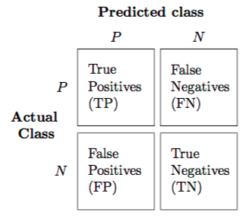

Modeling phase
Select a model to try to create a fit with (predict target well)
Set configuration parameters for model
Divide data in training set and test set
Train model with training set
Evaluate performance of trained model on the test set
Confusion matrix, mean square error, support, lift, false positives, false negatives
Optionally: tweak model parameters, add attributes, feed in more training data, choose different model
Eventually (hopefully): pick model plus parameters plus attributes that will reliably predict the target variable given new data
#DevoxxMA

Slide 23
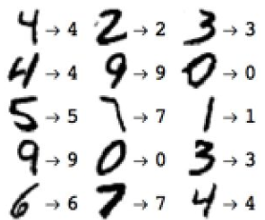
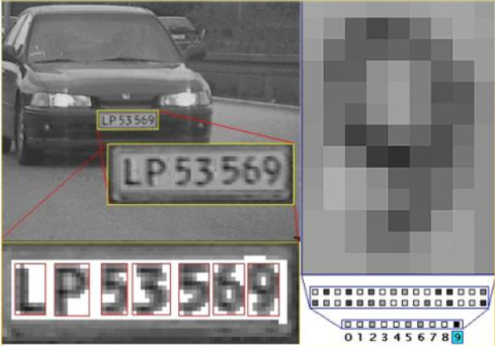
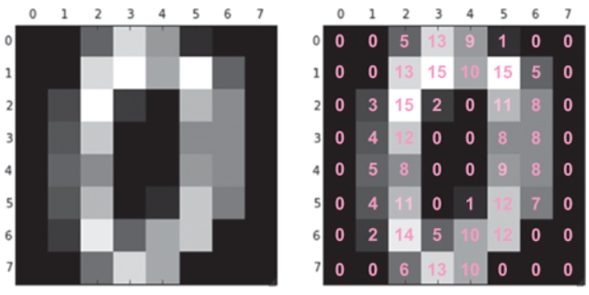
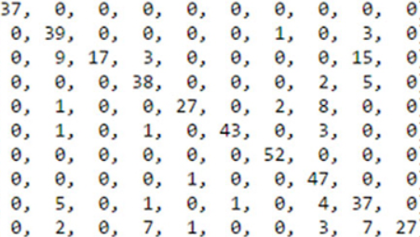
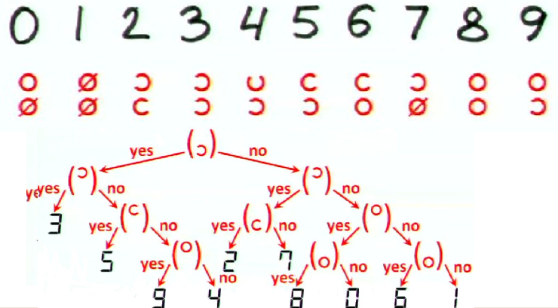
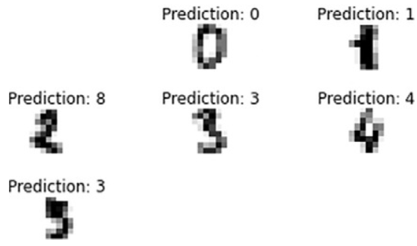
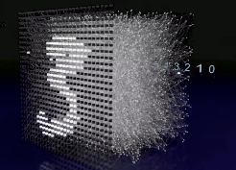
Optical Digit recognition
.
Naïve Bayes
Predicted
0 1 2 3 4 5 6 7 8 9
0
1
2
3
4
5
6
7
8
9
Actual
Decision Tree
Deep Neural Network
#DevoxxMA
Notes:
http://yann.lecun.com/exdb/mnist/ MNIST – handwritten images
https://www.cybercontrols.org/
http://scs.ryerson.ca/~aharley/vis/conv/

Slide 24
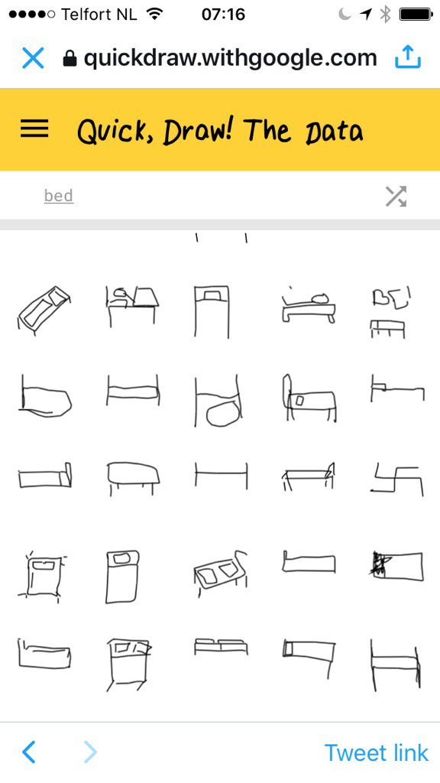
Classification gone wrong
Machine learning applied to millions of drawings on QuickDraw
to classify drawings
For example: drawings of beds
See for example:
https://aiexperiments.withgoogle.com/quick-draw
#DevoxxMA

Slide 25
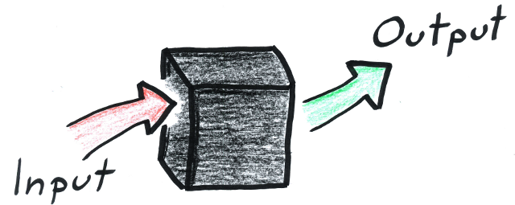
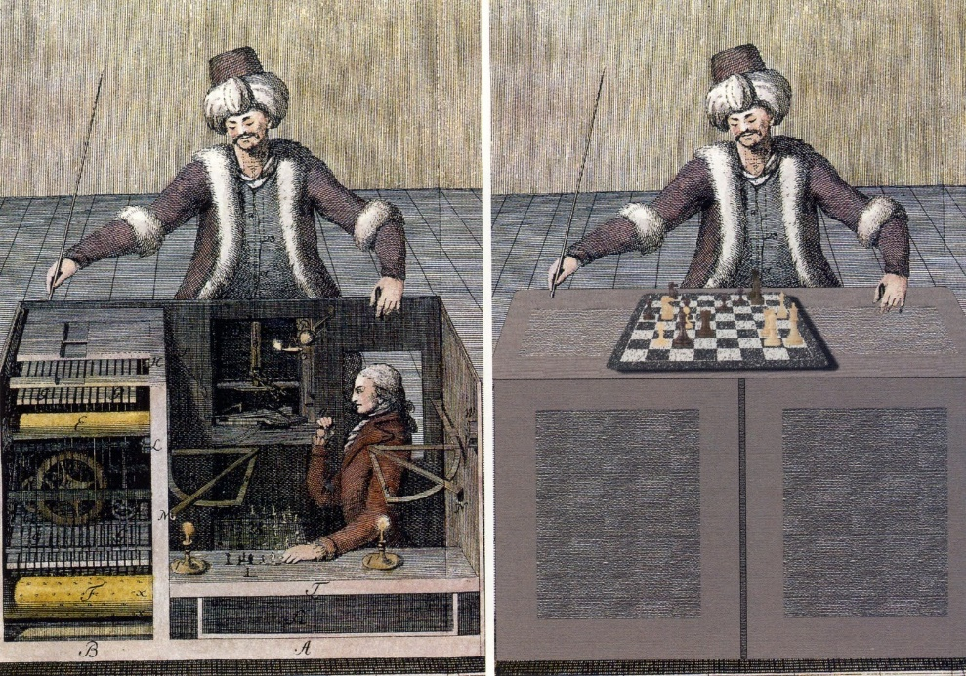
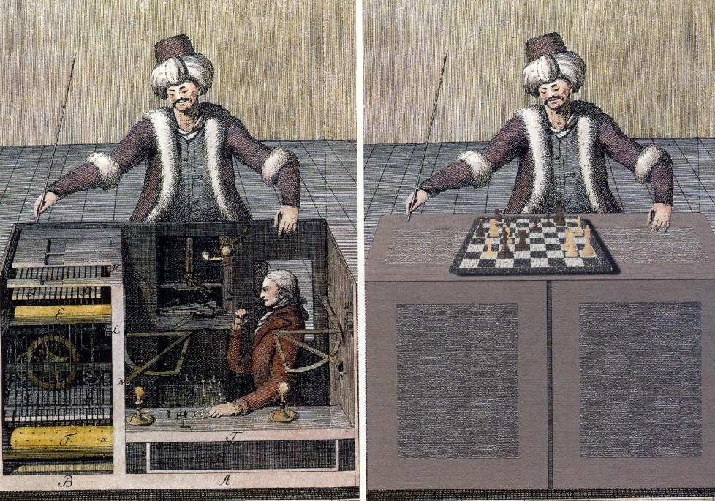
Machine learning ⬄ operational systems
“We have a model that will choose best chess move based on certain input”
#DevoxxMA

Slide 26
Machine learning ⬄ operational systems
Discovery => Model => Deploy
“We have a model that will predict a class (classification) or value (regression) based on certain input with a meaningful degree of accuracy” – how can we make use of that model?
#DevoxxMA

Slide 27
Deploy model and expose
Model is usually created on Big Data in Data Science environment using the Data Scientist’s tools
Model itself is typically fairly small
Model will be applied in operational systems against single data items (not huge collections nor the entire Big Data set)
Running the model online may not require extensive resources
Implementing the model at production run time
Export model (from Data Scientist environment) and import (into production environment)
Reimplement the model in the development technology and deploy (in the regular way) to the production environment
Expose model through API
#DevoxxMA

Slide 28
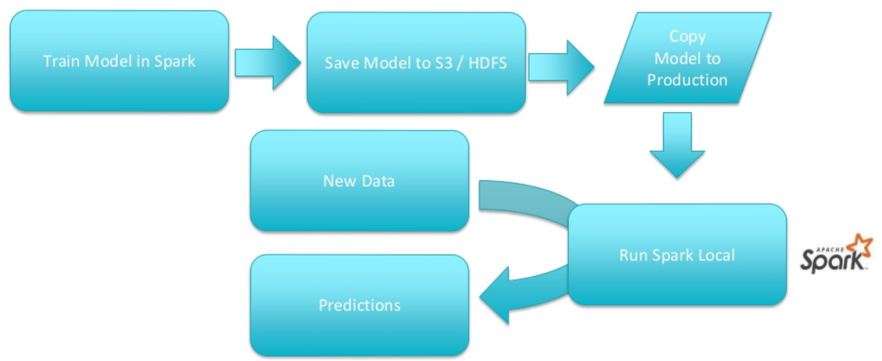
Deploy model and expose
REST API
#DevoxxMA

Slide 29


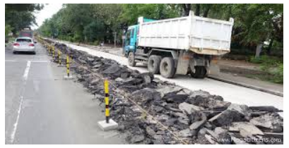
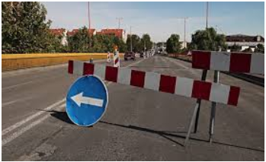
80M Pictures of Road
#DevoxxMA

Slide 30
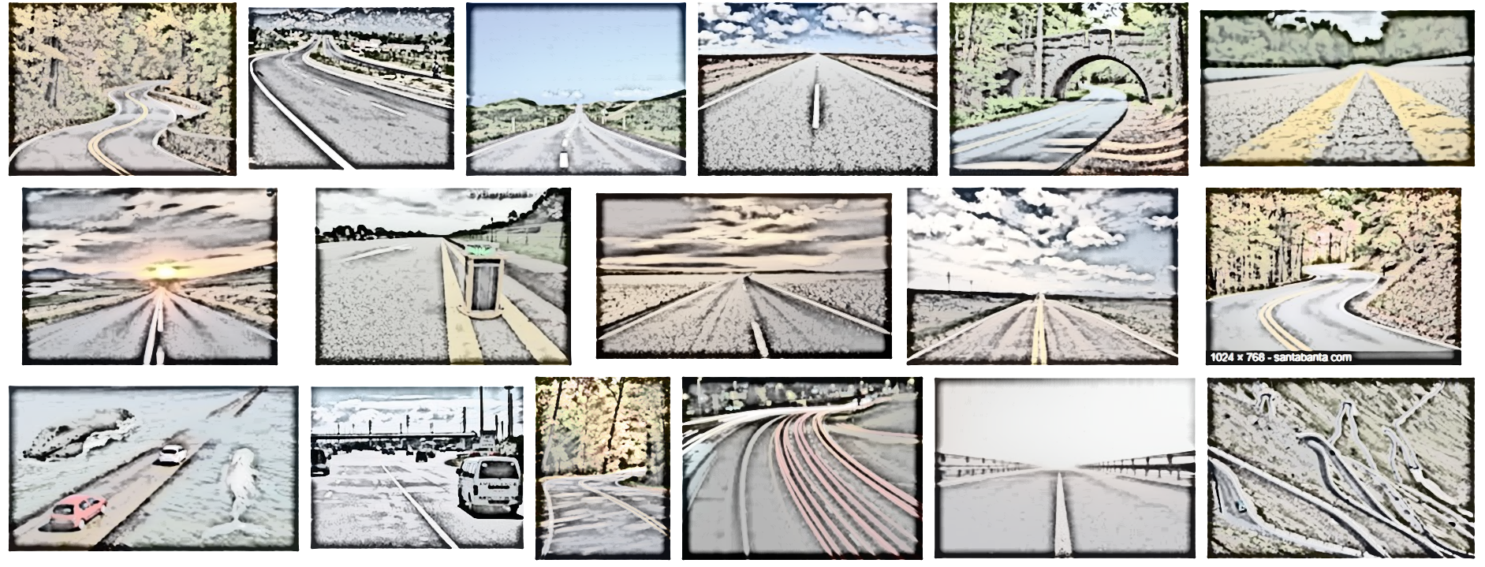
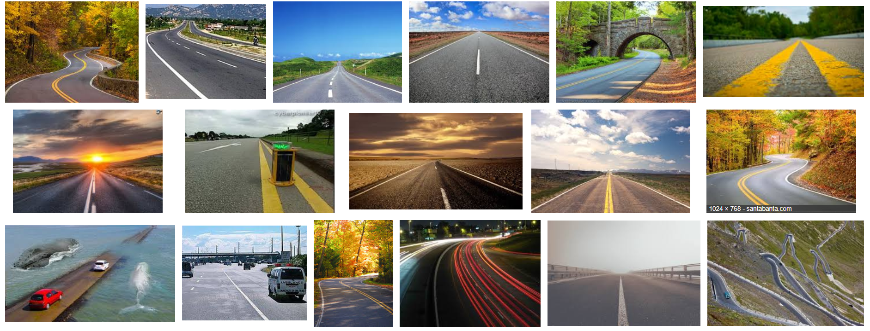
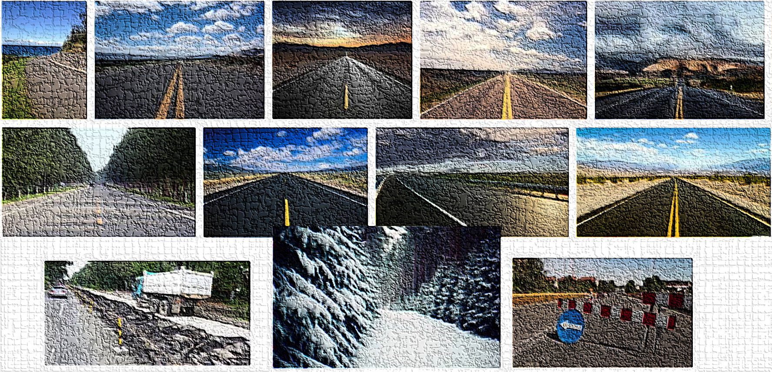
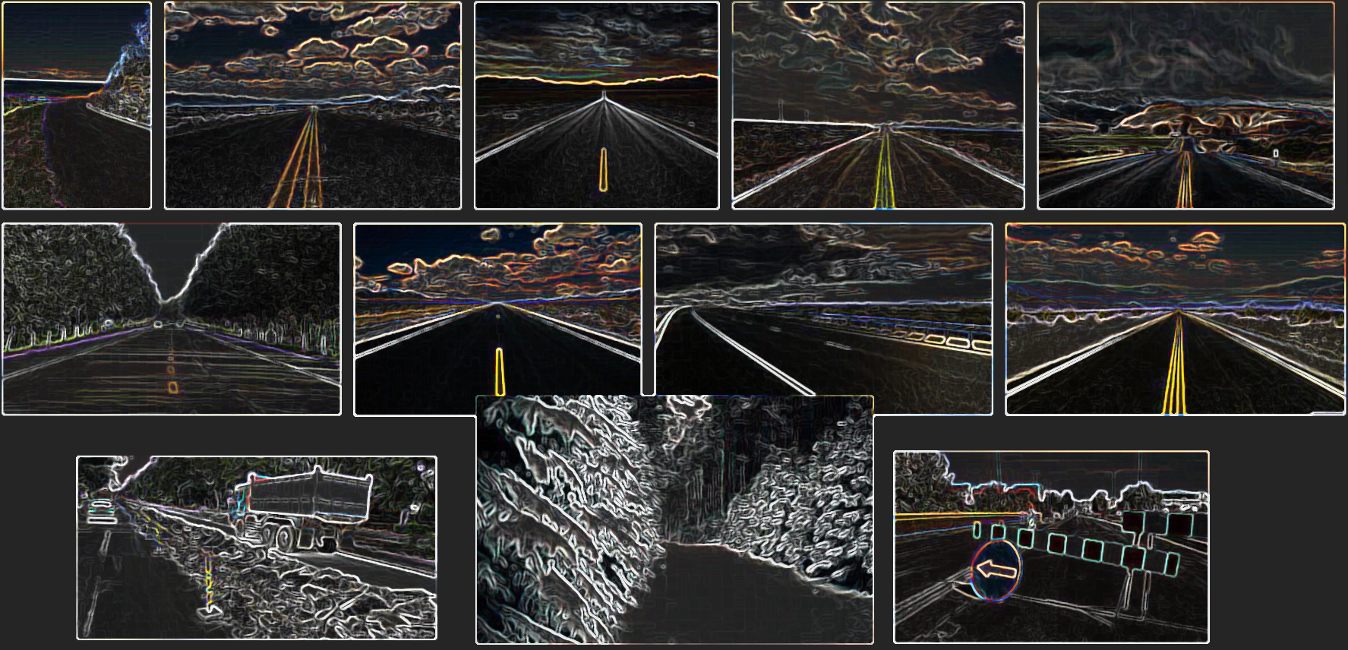
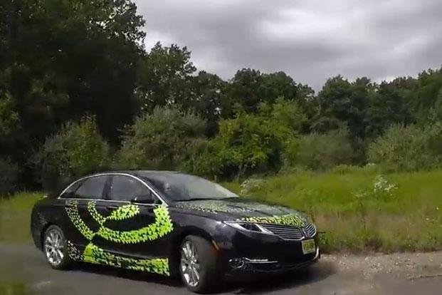
Big Data => Small ML Models
#DevoxxMA

Slide 31
Model management
Governance (new versions, testing and approval)
A/B testing
Auditing (what did the model decide and why? notifying humans? )
Evaluation (how well did the model’s output match the reality) to help evolve the model
for example recommendations followed
Monitor self learning models (to detect rogue models)
#DevoxxMA

Slide 32
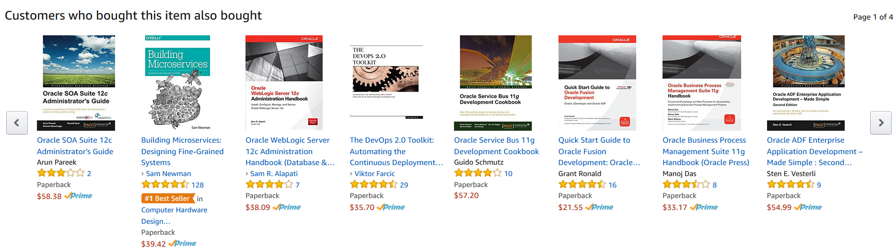
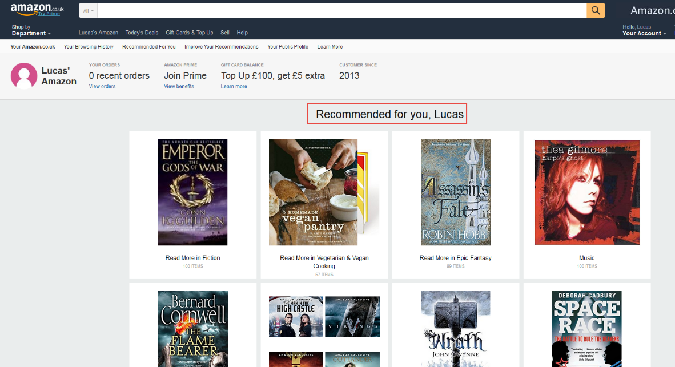
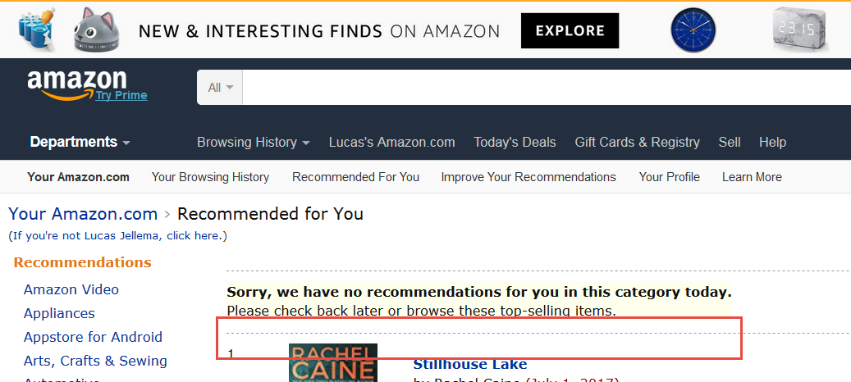
Deployment can also be: load results from model into production
#DevoxxMA

Slide 33
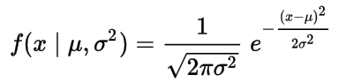
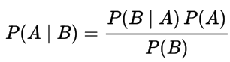
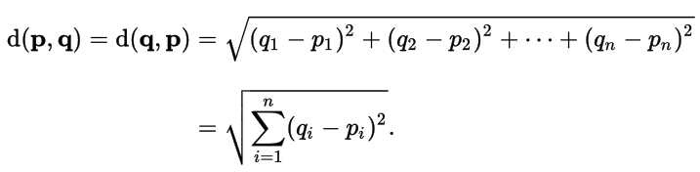


What to do it with?
Mathematics (Statistics)
Gauss (normal distribution)
Bayes’ Theorem
Euclidean Distance
Perceptron
Mean Square Error
#DevoxxMA

Slide 34

What to do it with?
#DevoxxMA

Slide 35
And of course
DATA
DATA
DATA
DATA
DATA
DATA
DATA
DATA
#DevoxxMA

Slide 36
How to pick Tools for the job
What are the jobs?
Gather data
Prepare data
Explore and (hopefully) Discover
Present
Embed & Deploy Model
What are considerations?
Volume
Speed and Time
Skills
Platform
Cost
#DevoxxMA

Slide 37



Popular Tools
#DevoxxMA

Slide 38

Popular frameworks & libraries
TensorFlow
DL4J
MxNet
Caffe
Keras
… many more
#DevoxxMA
Notes:
https://www.slideshare.net/AshishBansal17/tensorflow-vs-mxnet

Slide 39

Notebook – The Lab journal from the Datalab
Common format for data exploration and presentation
User friendly interface on top of powerful technologies
Somewhat similar to Java 9 jshell REPL
Most popular implementations
Jupyter (fka IPython)
Apache Zeppelin
Spark Notebook
Beaker
SageMath (SageMathCloud => CoCalc)
Oracle BigData Cloud Machine Learning Notebook UI
#DevoxxMA

Slide 40

Example notebook exploration
.
#DevoxxMA
Notes:
https://github.com/lucasjellema/theArtOfMachineLearning/blob/master/LinearRegression.ipynb
https://github.com/lucasjellema/jupyter-notebook-eredivisie/blob/master/EredivisieResults_2016_2017.ipynb
https://github.com/jadianes/spark-movie-lens/blob/master/notebooks/building-recommender.ipynb
https://github.com/justmarkham/DAT4/blob/master/notebooks/08_linear_regression.ipynb

Slide 41

Open Data
Governments and NGOs, scientific and even commercial organizations are publishing data
Inviting anyone who wants to join in to help make sense of the data – understand driving factors, identify categories, help predict
Many areas
Economy, health, public safety, sports, traffic &transportation, games, environment, maps, …
#DevoxxMA

Slide 42


Open data – some examples
Kaggle - Data Sets and [Samples of] Data Discovery: www.kaggle.com
US, EU and Moroccon Government Data: data.gov, open-data.europa.eu & morocco.opendataforafrica.org
Open Images Data Set: www.image-net.org
Open Data From World Bank: data.worldbank.org
Historic Football Data: api.football-data.org
New York City Open Data - opendata.cityofnewyork.us
Airports, Airlines, Flight Routes: openflights.org
Open Database – machine counterpart to Wikipedia: www.wikidata.org
Google Audio Set (manually annotated audio events) - research.google.com/audioset/
Movielens - Movies, viewers and ratings: files.grouplens.org/datasets/movielens/
#DevoxxMA

Slide 43


What is Hadoop?
Big Data means Big Computing and Big Storage
Big requires scalable => horizontal scale out
Moving data is very expensive (network, disk IO)
Rather than move data to processor – move processing to data: distributed processing
Horizontal scale out => Hadoop: distributed data & distributed processing
HDFS – Hadoop Distributed File System
Map Reduce – parallel, distributed processing
Map-Reduce operates on data locally, then persists and aggregates results
#DevoxxMA

Slide 44
What is Spark?
Developing and orchestrating Map-Reduce on Hadoop is not simple
Running jobs can be slow due to frequent disk writing
Spark is for managing and orchestrating distributed processing on a variety of cluster systems
with Hadoop as the most obvious target
through APIs in Java, Python, R, Scala
Spark uses lazy operations and distributed in-memory data structures – offering much better performance
Through Spark – cluster based processing can be used interactively
Spark has additional modules that leverage distributed processing for running prepackaged jobs (SQL, Graph, ML, …)
#DevoxxMA

Slide 45

Apache Spark overview
.
#DevoxxMA

Slide 46

Example running against Apache Spark
https://github.com/jadianes/spark-movie-lens/blob/master/notebooks/building-recommender.ipynb
#DevoxxMA

Slide 47



Demo: Classification
#DevoxxMA

Slide 48


Demo: Conference Abstract Classification Challenge
Take all conference abstracts for
Train a Classification Model on picking the Conference Track
Based on Title, Summary, Speaker, Level
Use the Model to pick the Track for sessions at
#DevoxxMA

Slide 49

Demo: Conference Abstract Classification Challenge
One approach: Load session data in an Oracle Database table
Leverage the built in Advanced Analytics machine learning features to
train the model on data in the database (using to Naïve Bayes)
apply the model in [semi] regular SQL queries
#DevoxxMA

Slide 50
Demo: Conference Abstract Classification Challenge
DECLARE
xformlist dbms_data_mining_transform.TRANSFORM_LIST;
BEGIN
DBMS_DATA_MINING_TRANSFORM.SET_TRANSFORM( xformlist, 'abstract', NULL, 'abstract', NULL, 'TEXT(TOKEN_TYPE:NORMAL)');
DBMS_DATA_MINING.CREATE_MODEL ( model_name => 'SESSION_CLASS_NB'
, mining_function => dbms_data_mining.classification
, data_table_name => 'J1_SESSIONS'
, case_id_column_name => 'session_title'
, target_column_name => 'session_track'
, settings_table_name => 'session_class_nb_settings'
, xform_list => xformlist);
END;
#DevoxxMA

Slide 51



Demo: Conference Abstract Classification Challenge
#DevoxxMA

Slide 52

Demo: Conference Abstract Classification Challenge
#DevoxxMA

Slide 53
Demo: Conference Abstract Classification Challenge
#DevoxxMA

Slide 54


Humans learning machine learning: Your first steps
#DevoxxMA

Slide 55



Humans learning machine learning: Your first steps
Jupyter Notebooks and Python – tmpnb.org
HortonWorks Sandbox VM – Hadoop & Spark & Hive, Ambari
DataBricks Cloud Environment with Apache Spark (free trial)
Oracle Big Data Lite – Prebuilt Virtual Machine
Tutorials, Courses (Udacity, Coursera, edX)
Books
Introducing Data Science
Learning Apache Spark 2
Python Machine Learning
#DevoxxMA

Slide 56

Machine Learning applied to Weather Control
https://www.youtube.com/watch?v=QAwL0O5nXe0
#DevoxxMA

Slide 57
Summary
IoT, Big Data, Machine Learning => AI
Democratization
Algorithms, Storage and Compute Resources, High Level Machine Learning Frameworks, Education resources , Open Data, Trained ML Models, Out of the Box SaaS capabilities – powered by ML
Produce business value today
Machine Learning by computers helps us(ers) understand historic data and apply that insight to new data
Developers have to learn how to incorporate Machine Learning into their applications – for smarter Uis, more automation, faster (p)reactions
#DevoxxMA

Slide 58
Summary (2)
R and Python are most popular technologies for data exploration and ML model discovery [on small subsets of Big Data]
Apache Spark (on Hadoop) is frequently used to powercrunch data (wrangling) and run ML models on Big Data sets
Notebooks are a popular vehicle in the Data Science lab
To explore and report
Getting started on Machine Learning is fun, smart and well supported
#DevoxxMA

Slide 59

Thank You!
Lucas Jellema
AMIS (The Netherlands)
@lucasjellema
technology.amis.nl
#DevoxxMA

Slide 60
References
AI Adventures (Google) https://www.youtube.com/watch?v=RJudqel8DVA
Twitch TV https://www.twitch.tv/videos/179940629 and sources on GitHub: https://github.com/sunilmallya/dl-twitch-series
Tensor Flow & Deep Learning without a PhD (Devoxx) https://www.youtube.com/watch?v=vq2nnJ4g6N0
And many more
#DevoxxMA

